Slide 1
Ch 9 Joints- Articulations
-between bones, cartilage and bones, or teeth and bones

Slide 2
Functional Classification
1. Immovable / synarthrotic
2. Slightly movable / amphiarthrotic
3. Freely movable / diarthrotic

Slide 3
Structural Classification
1. Fibrous – many collagenous fibers
-lie between bones that are in close contact
Examples:
a. Syndesmoses- ligament can be twisted, amphiarthrotic
ex: distal ends of tibia & fibula
b. Suture- between flat bones, synarthrotic
ex: skull
c. Gomphoses- cone-shaped bony process meets bony socket, synarthrotic
ex: root of tooth

Slide 4
Structural Classification
2. Cartilaginous- cartilage connects
Examples:
a. Synchondroses- hyaline or costal cartilage
ex: b/w 1st ribs & sternum
epiphyseal disk – no movement after age 25 (synarthrotic)
b. Symphysis- broad flat disk of fibrocartilage, amphiarthrotic
ex: pubic symphysis, intervertebral disks

Slide 5
3. Synovial- allow free movements *most joints fit this classification
Examples:
a. Ball & Socket- movement in all planes ex: hip, shoulder
b. Condyloid- condyle of one bone fits into cavity of another
ex: metacarpals into phalanges
c. Gliding/Planar- back and forth motion, nearly flat
ex: wrist and ankle
d. Hinge- convex surface of one bone fits into the concave surface of another
ex: elbow and knee
e. Pivot- ex: head side to side, between radius and ulna
f. Saddle- between bones that fit together
ex: carpals and metacarpals

Slide 6
Accessory Structures
Ligaments- bone to bone, Support, strengthen and reinforce joints
Tendons- muscle to bone, Helps support joint
Bursae- synovial fluid filled sacs, provide cushion where tendons/ligaments rub
Bursitis
-when bursae become inflamed whenever tendon/ligaments move
-can be associated with repetitive motion or pressure to joint area
Bunion
-over the base of the great toe from friction, tight shoes
Menisci- disks of fibrocartilage that divide joint into two compartments, articular discs, allow variations in shapes of bones at joint
Fat pads - protects articular cartilage, packing material (filler) when bones move

Slide 7
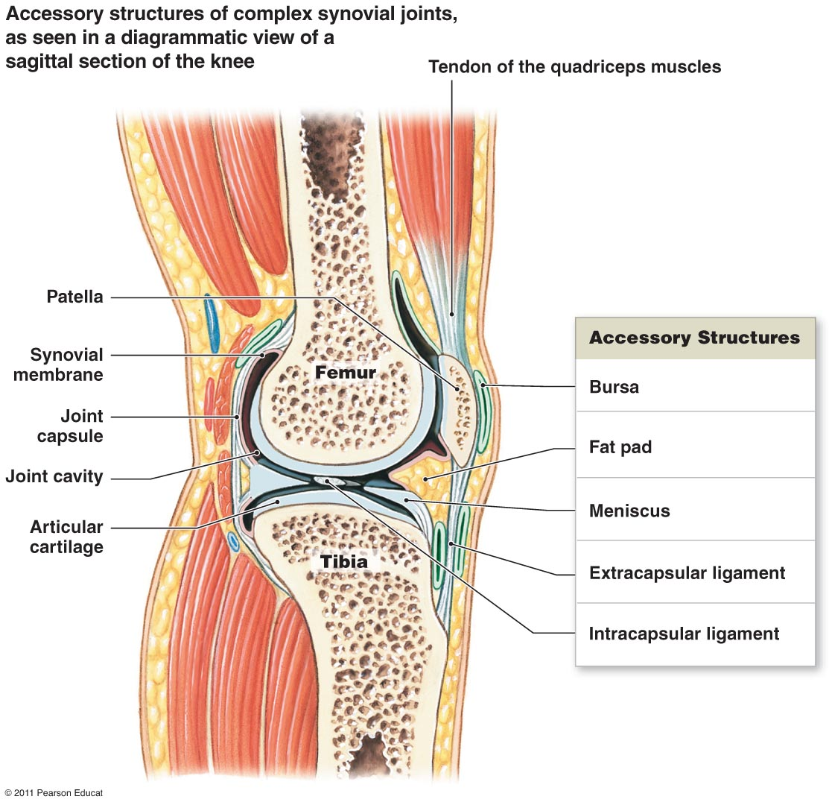

Slide 8
Preventing injury = limiting range of motion/stabilizing joint
Factors responsible for limiting ROM:
Collagen fibers (joint capsule, ligaments)
Shape of articulating surfaces and menisci
Other bones, muscles, or fat pads
Tendons of articulating bones
If movement occurs beyond ROM = damage
Sprain
ligaments with some torn collagen fibers
Ligament as a whole survives and joint is not damaged
Dislocation (luxation)
Articulating surfaces forced out of position
Damages articular cartilage, ligaments, joint capsule
Affects nutrient distribution & shock absorption
Subluxation: partial dislocation

Slide 9
9-3 Joint Movement
Refer to chart from outline

Slide 10
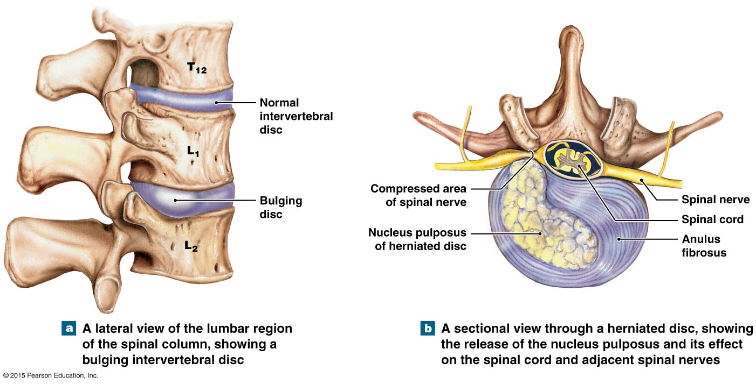
Intervertebral Discs
Separate vertebrae, pads of fibrocartilage
Not found b/w 1st & 2nd or at sacrum or coccyx
Slipped disc- nucleus pulposus distort the annulus fibrosus, forcing it into vertebral canal
Herniated disc- nucleus pulposus breaks through the annulus fibrosus, distorts/compresses sensory nerves

Slide 11
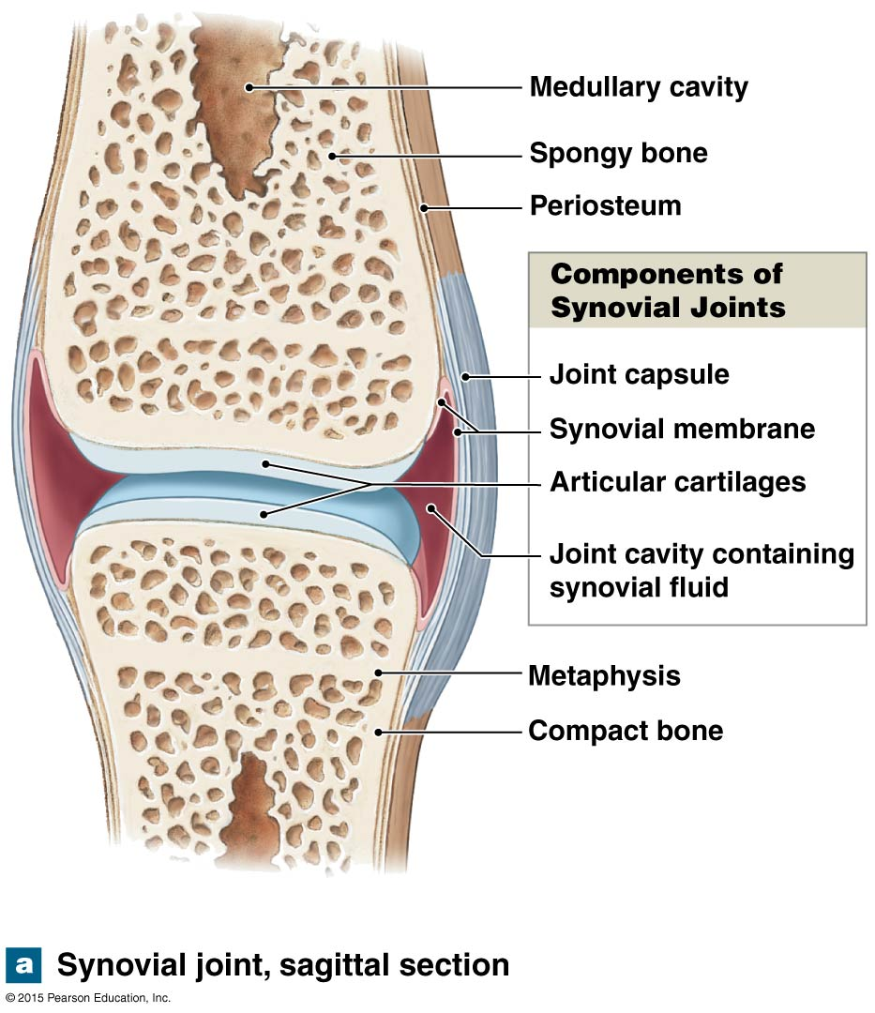
Parts of a synovial joint
1. Articular Cartilage- covers the ends of the bones, resists wear, minimizes friction
2. Joint capsule- holds bones together
-lined by synovial membrane
3. Joint cavity- filled with synovial fluid
4. Ligaments- reinforce the capsule

Slide 12
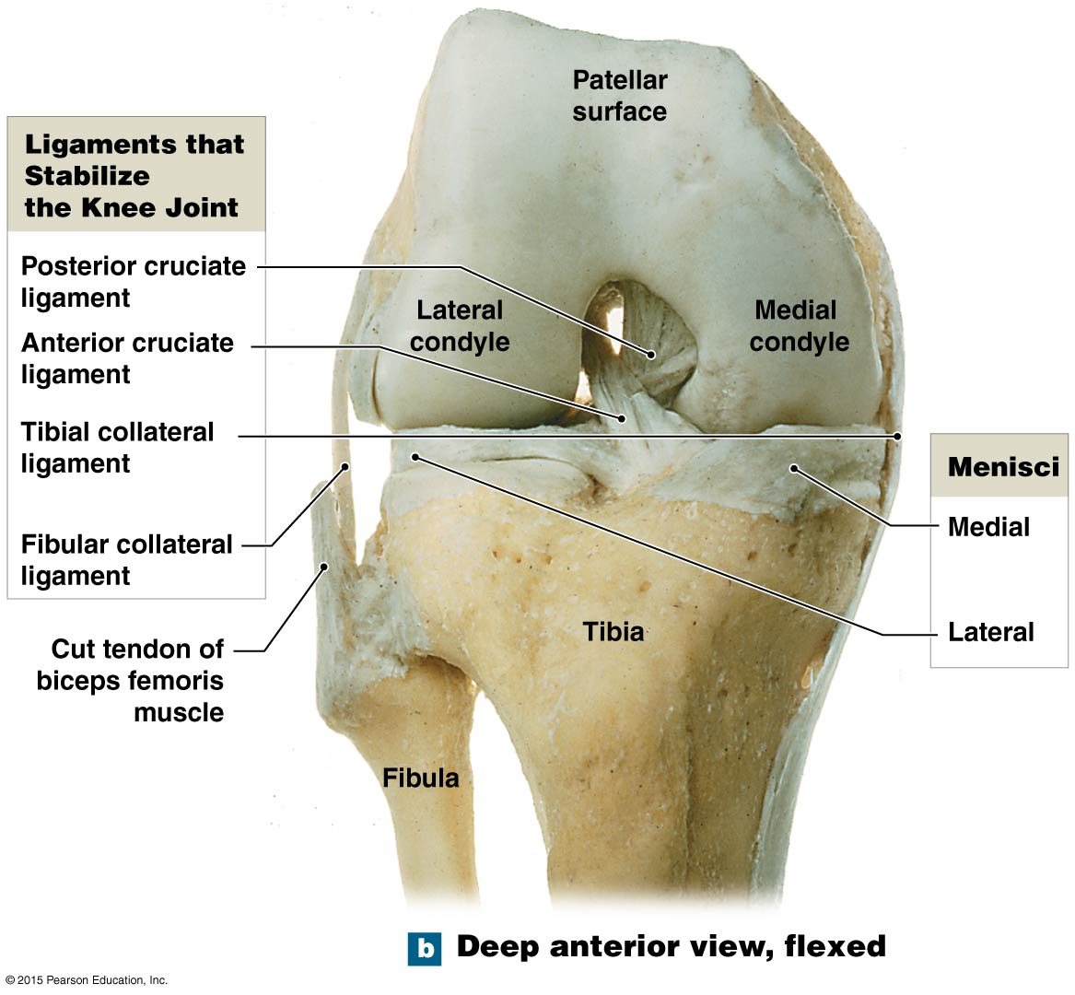
MCL-medial
LCL- lateral

Slide 13
Aging
Rheumatism
A pain and stiffness of skeletal and muscular systems
Several major forms
Arthritis
All forms of rheumatism that damage articular cartilages of synovial joints
Damage results from: Infection, Injury to joint, Metabolic problems, Severe physical stresses
Osteoarthritis | Caused by: wear & tear of joint surfaces Genetic factors affecting collagen formation Generally affects people 60 or older
Rheumatoid arthritis | Inflammatory condition Caused by: Infection Allergy Autoimmune disease: body attacks own tissues
Gouty arthritis | Buildup of uric acid crystals in synovial fluid interferes w/ joint movement Caused by: Gout Calcification of joints in people over 85

