Slide 1
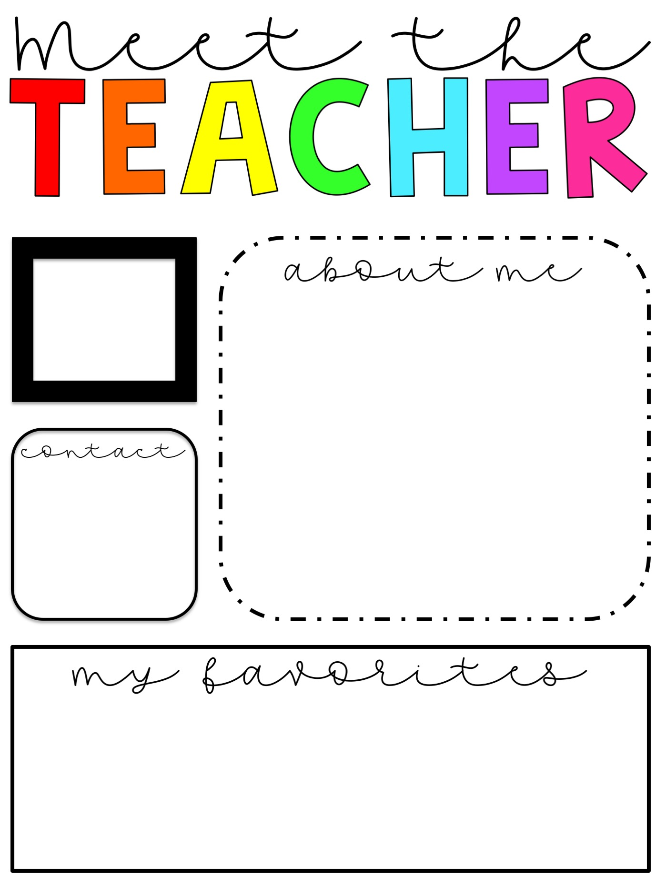
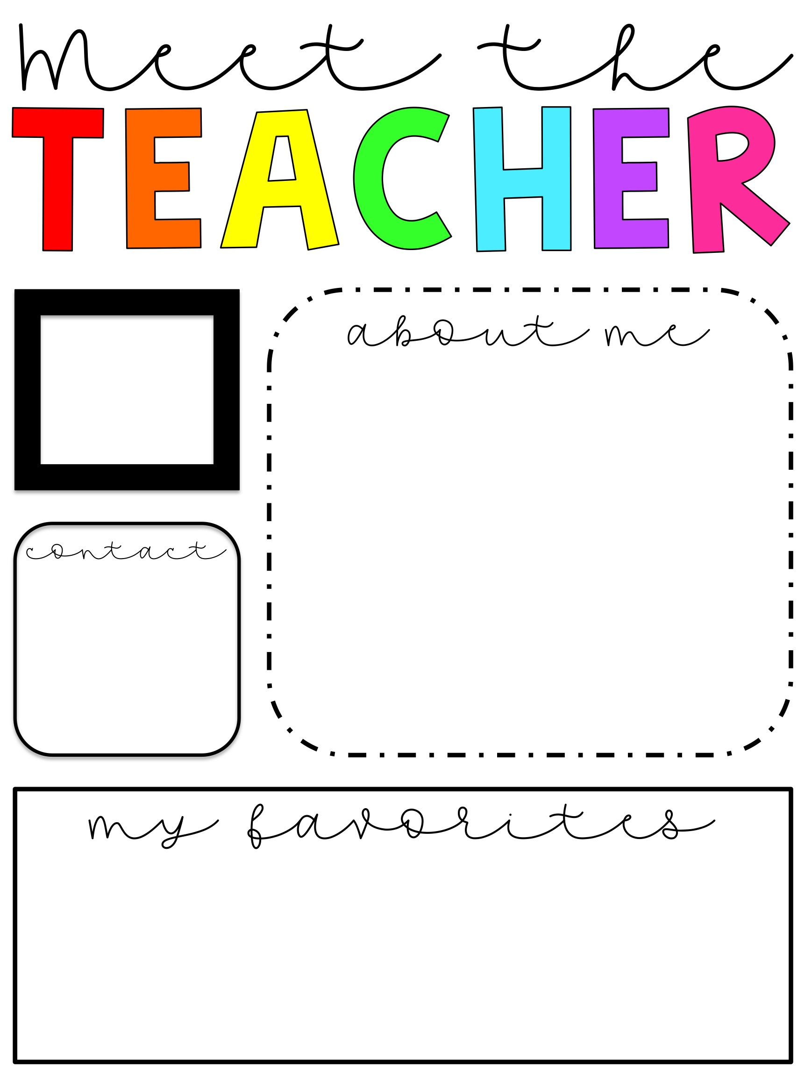
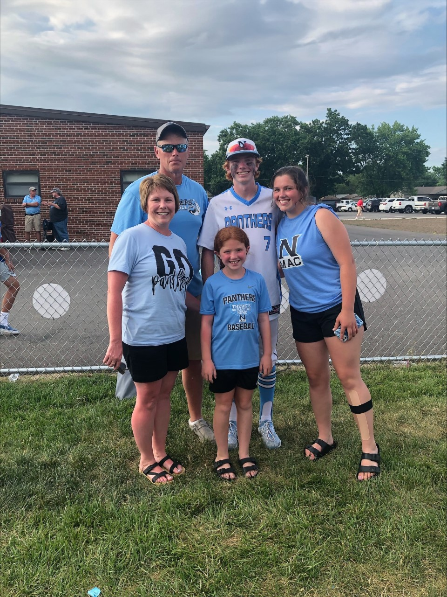
Insert picture here
Hello, my name is Mrs. Amanda Hendricks! I am so excited to be your child’s Kindergarten teacher for the 2021-2022 school year! My husband and I have three children: Matthew – 18, Abby – 15, and Alyse – 9. I received my bachelor’s degree from Illinois Wesleyan University in 1999 and my master’s degree in reading education from Grand Canyon University in 2010. This is my 21st year of teaching.
School Phone:
217-965-5424
Email: ahendricks@northmacschools.org
Food: Spaghetti
Hobby: Reading and watching my children’s sporting events
Color: Pink
Season: Fall
Snack: chocolate
Drink: Iced Tea
I can’t wait to spend the year laughing and learning with your child!

Slide 2

Insert picture here
Write your about me note here
Insert contact info here
Insert favorites here

Slide 3
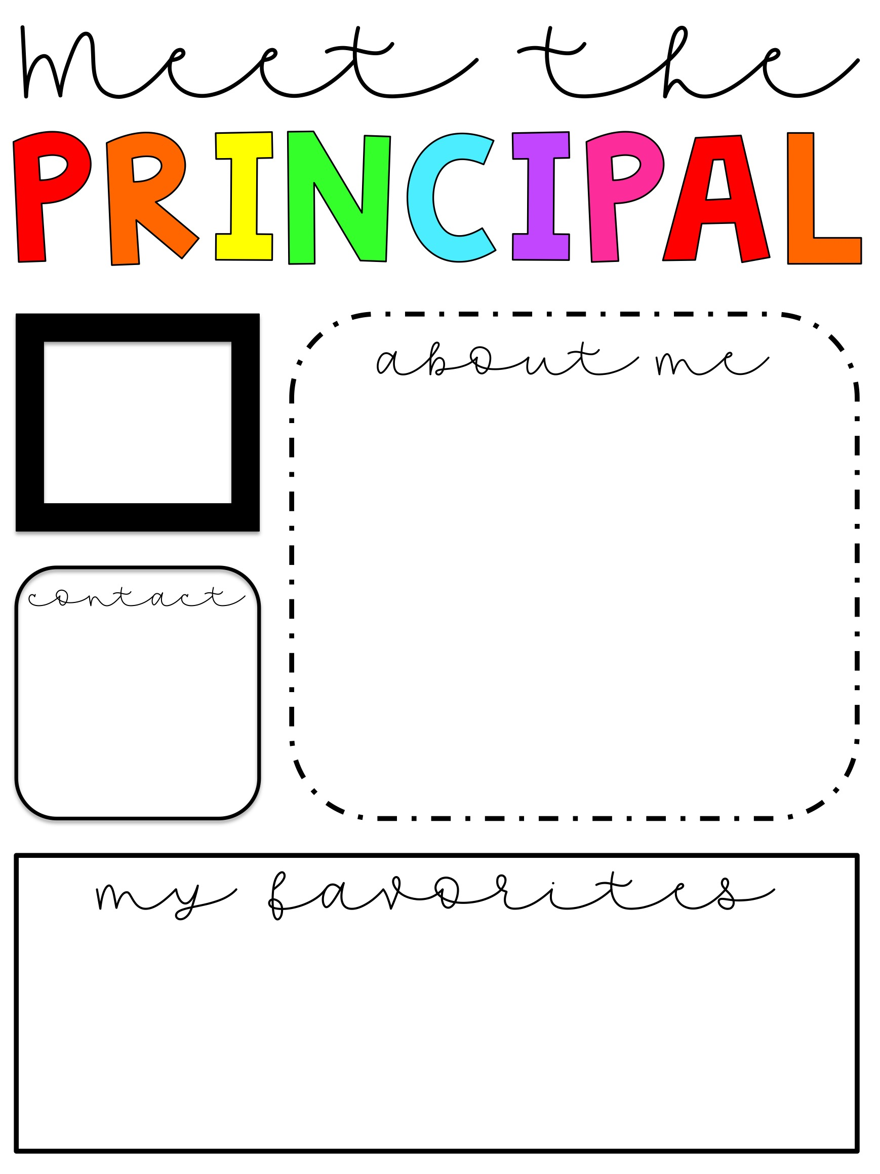
Insert picture here
Write your about me note here
Insert contact info here
Insert favorites here

Slide 4
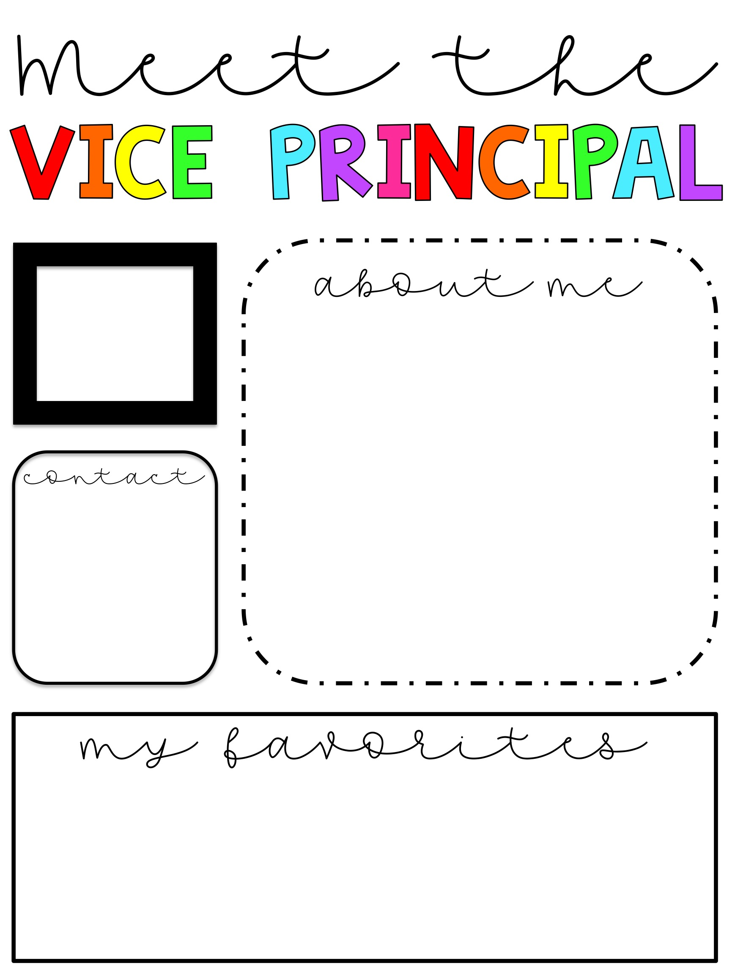
Insert picture here
Write your about me note here
Insert contact info here
Insert favorites here

Slide 5

Insert picture here
Write your about me note here
Insert contact info here
Insert favorites here

Slide 6
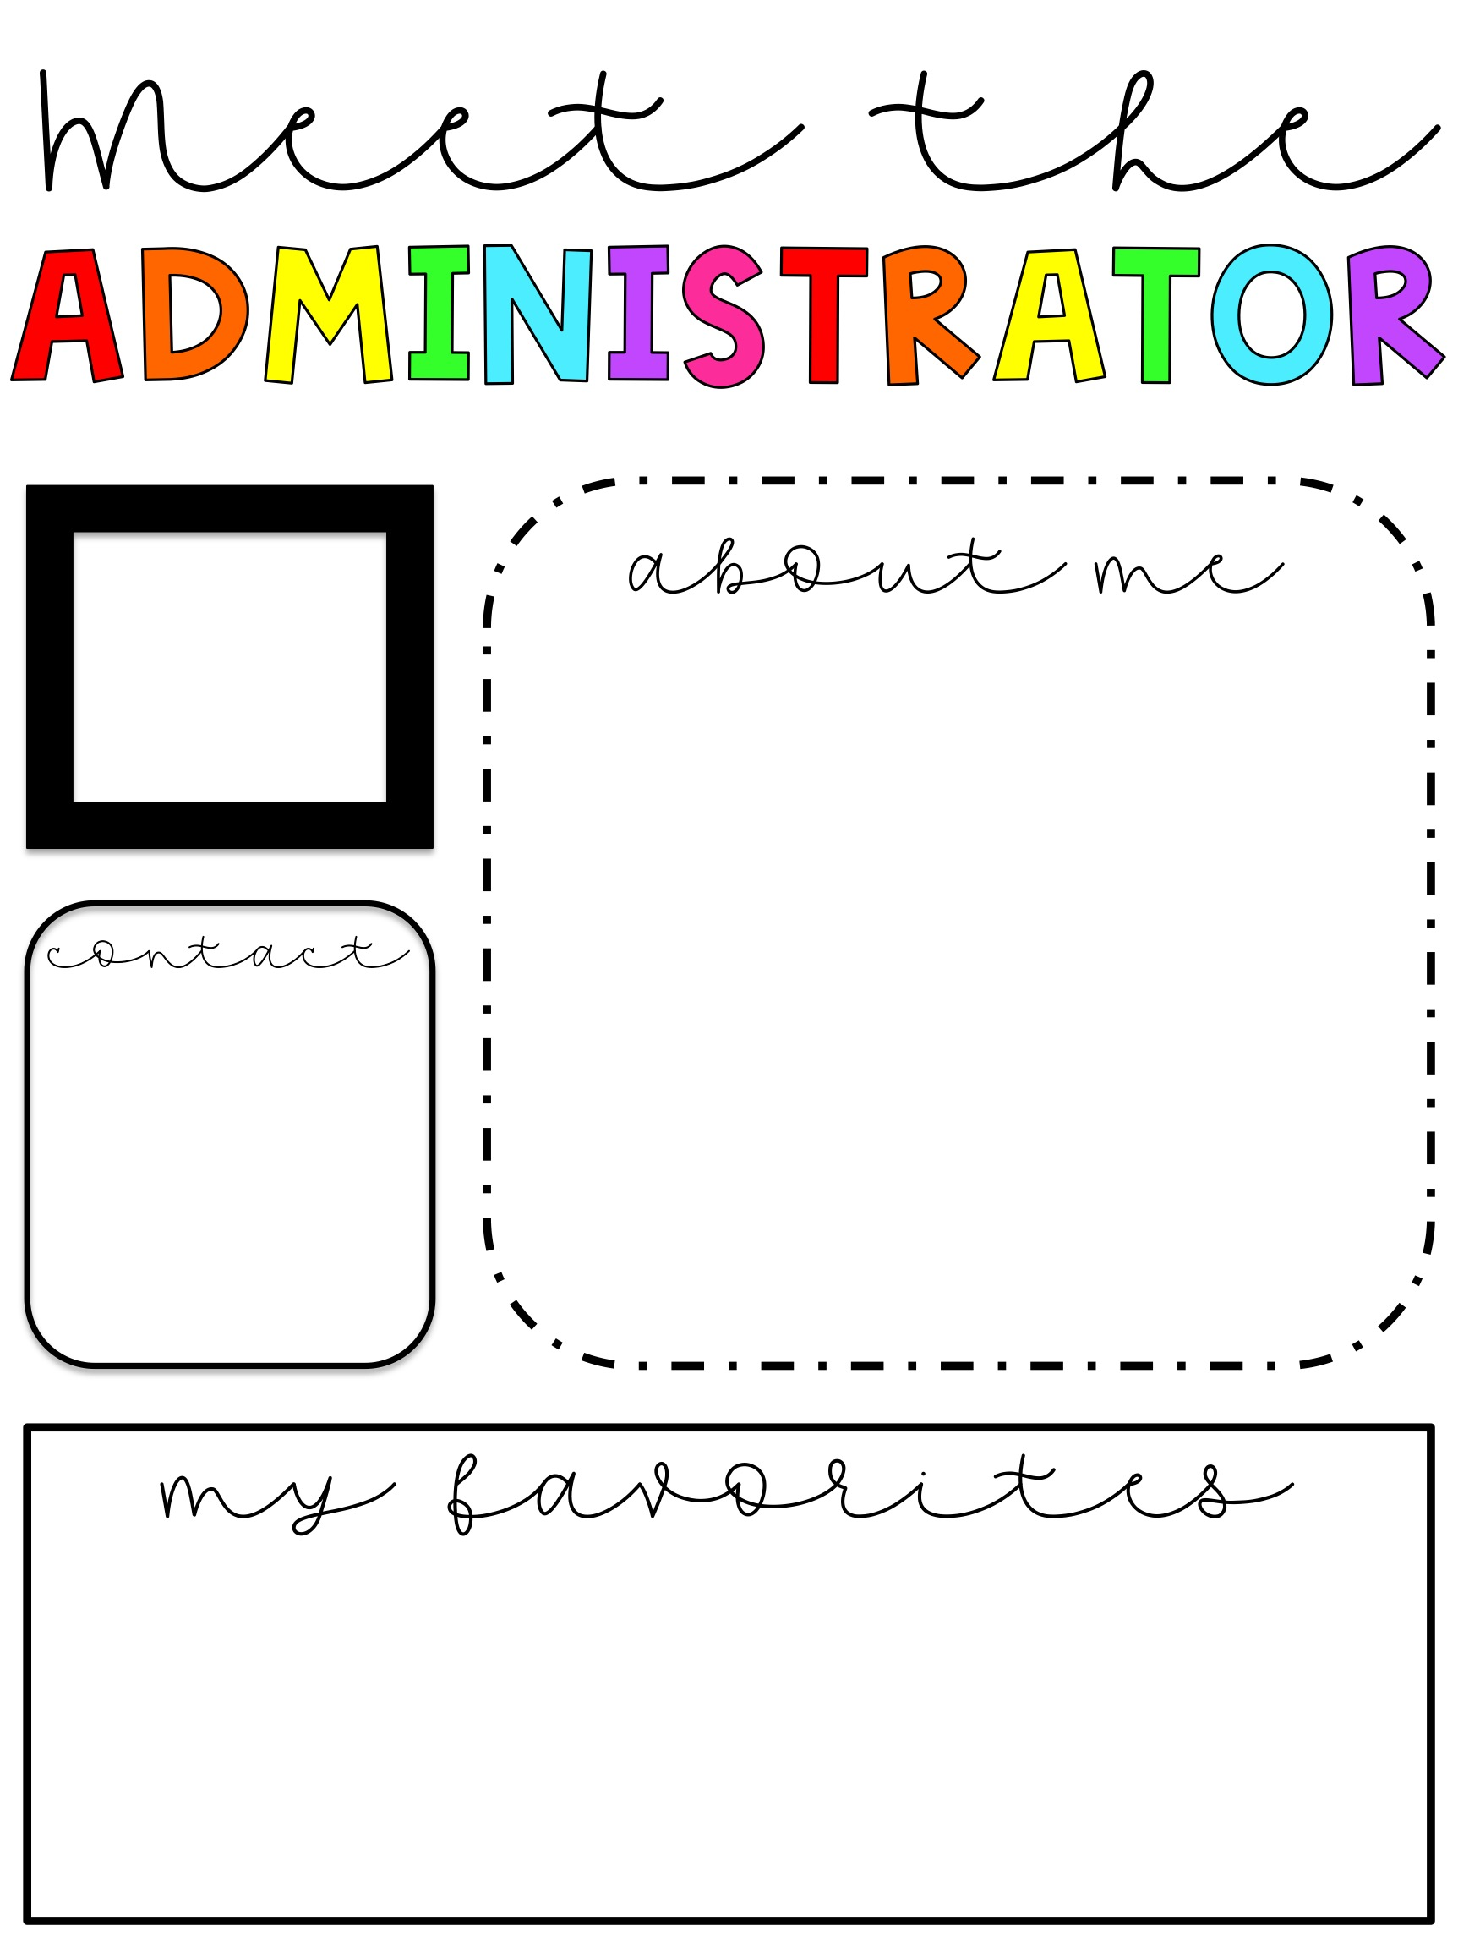
Insert picture here
Write your about me note here
Insert contact info here
Insert favorites here

Slide 7

Insert picture here
Write your about me note here
Insert contact info here
Insert favorites here

Slide 8
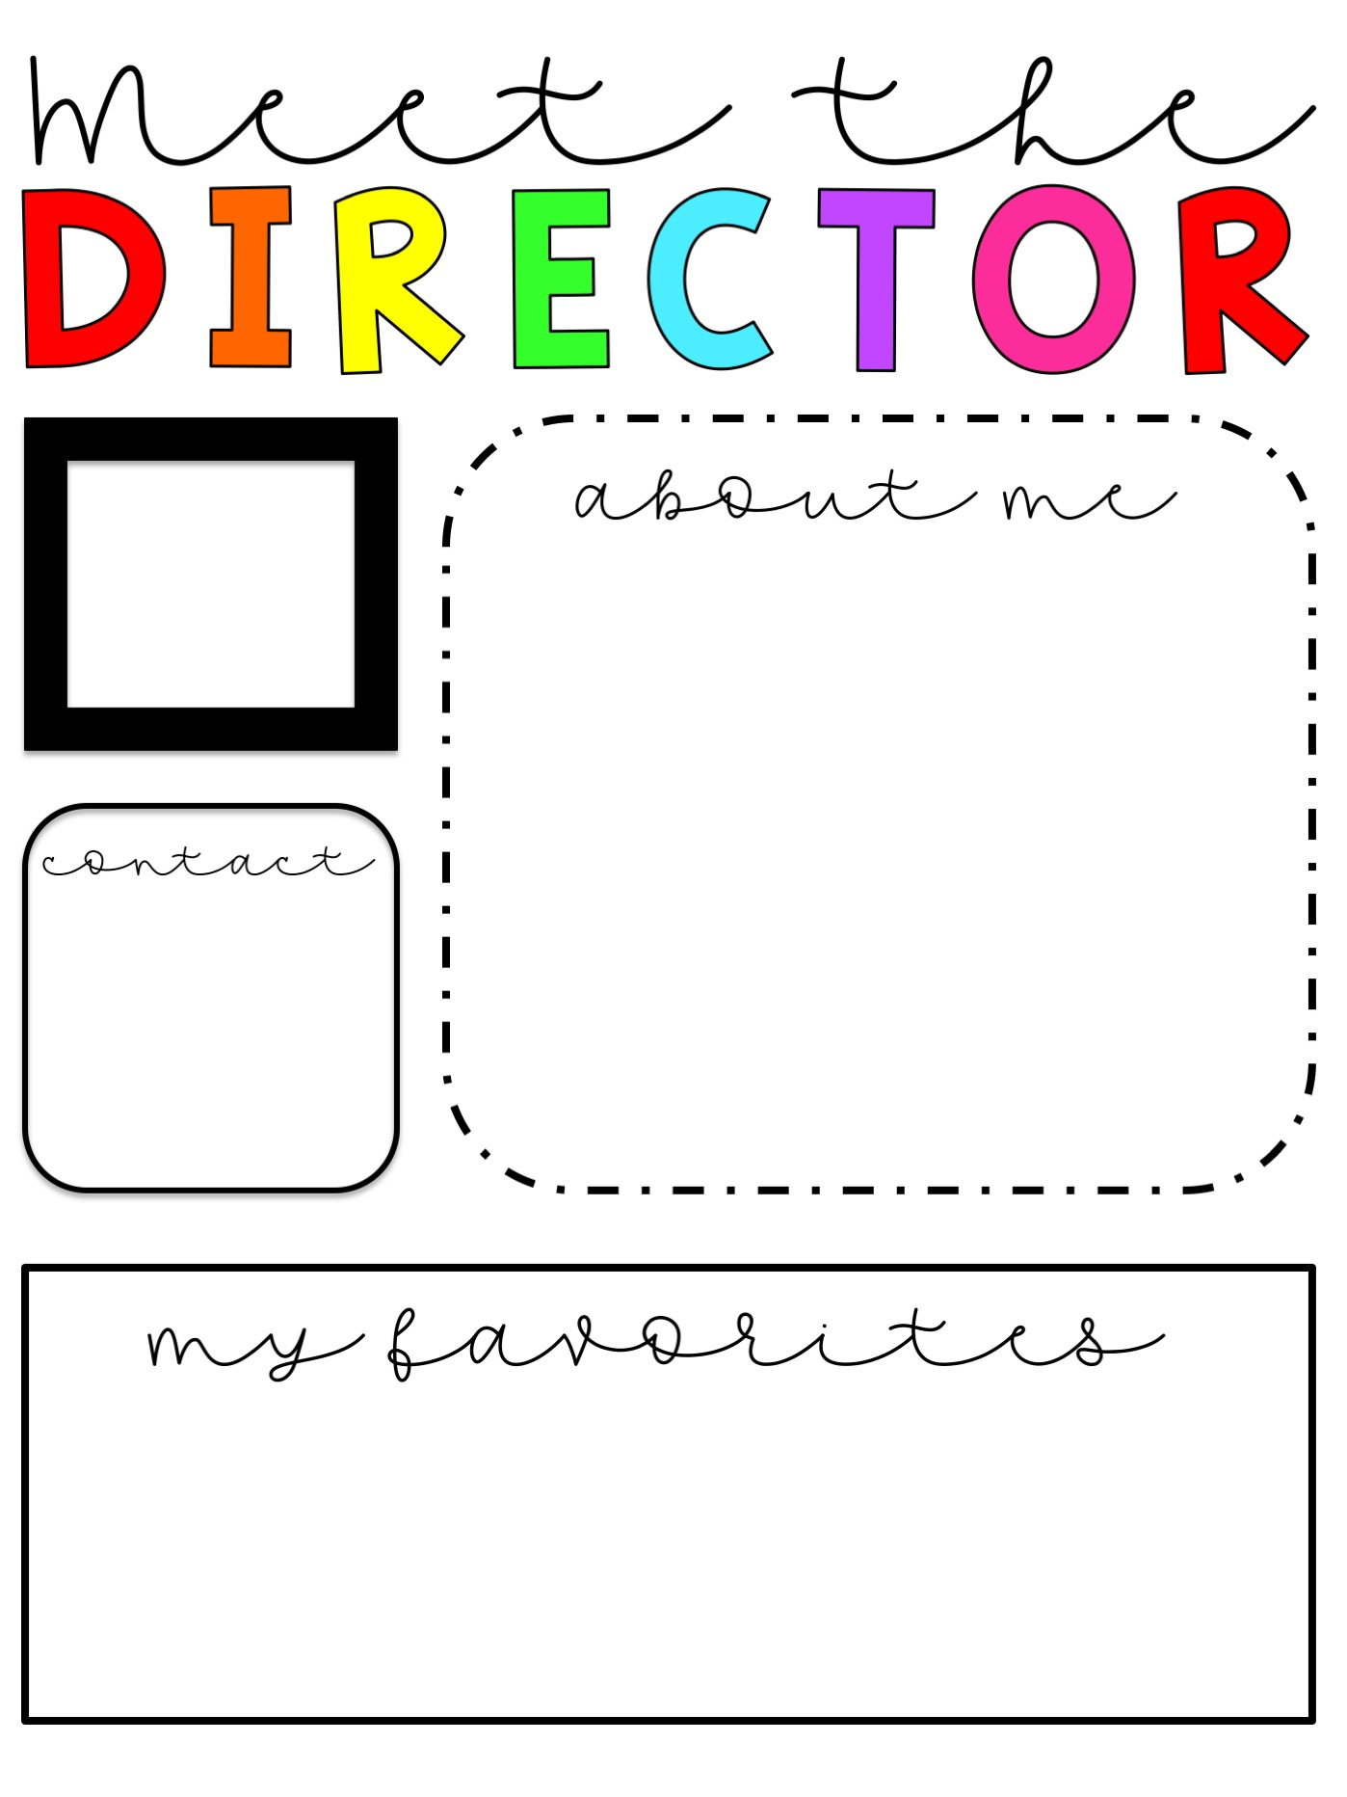
Insert picture here
Write your about me note here
Insert contact info here
Insert favorites here

Slide 9

Insert picture here
Write your about me note here
Insert contact info here
Insert favorites here

Slide 10
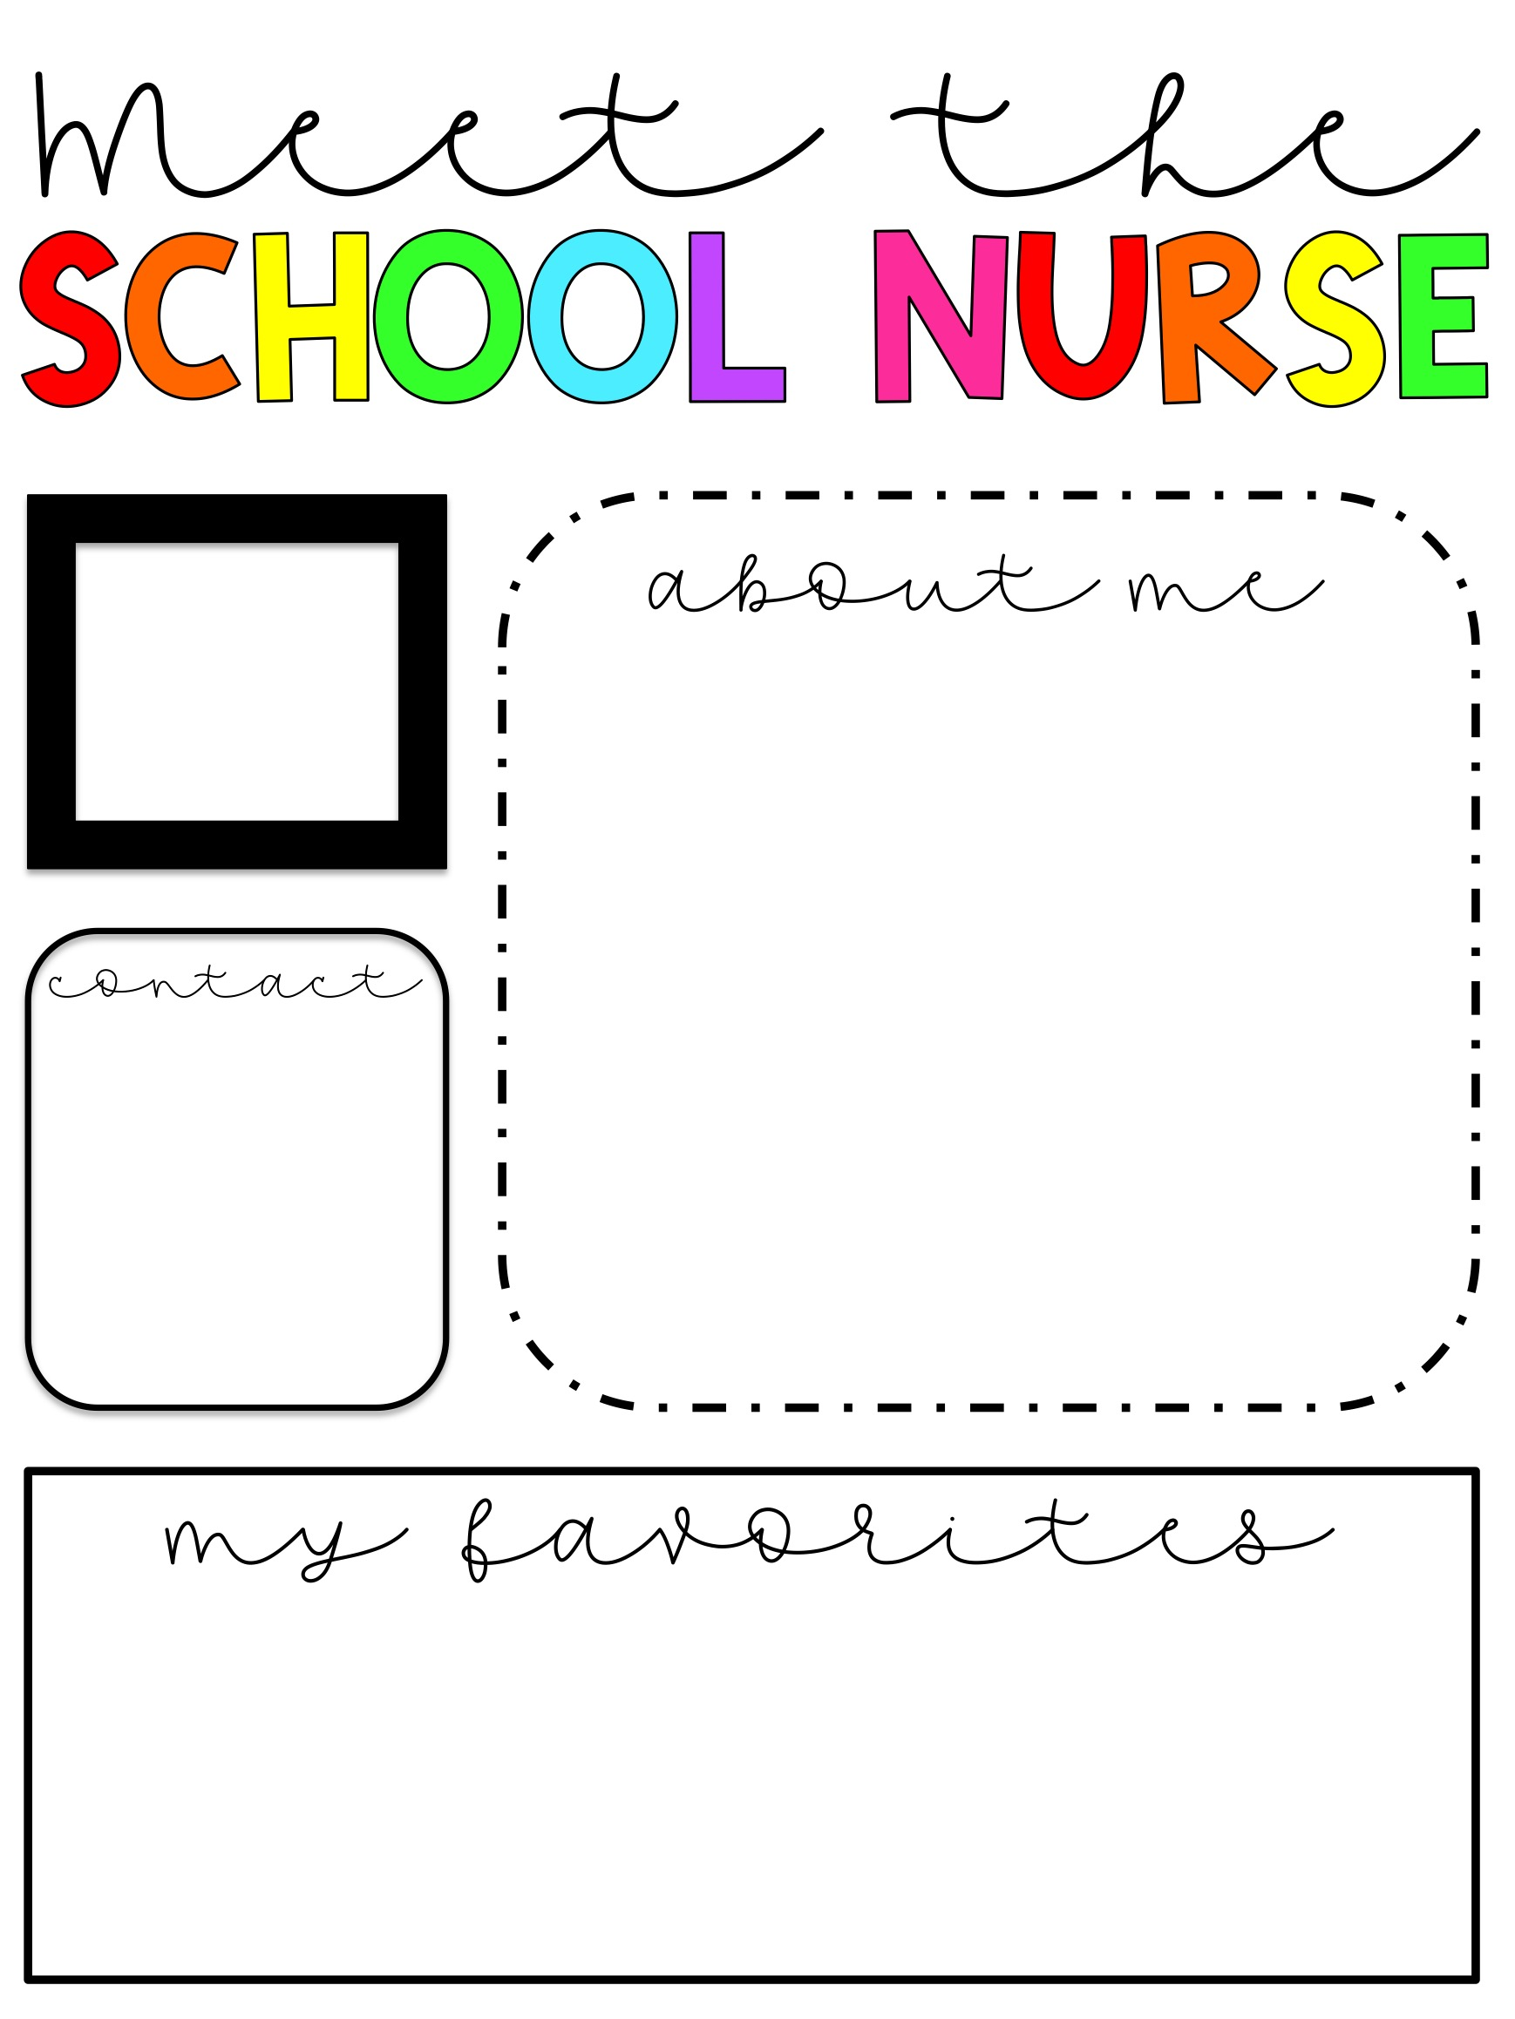
Insert picture here
Write your about me note here
Insert contact info here
Insert favorites here

Slide 11
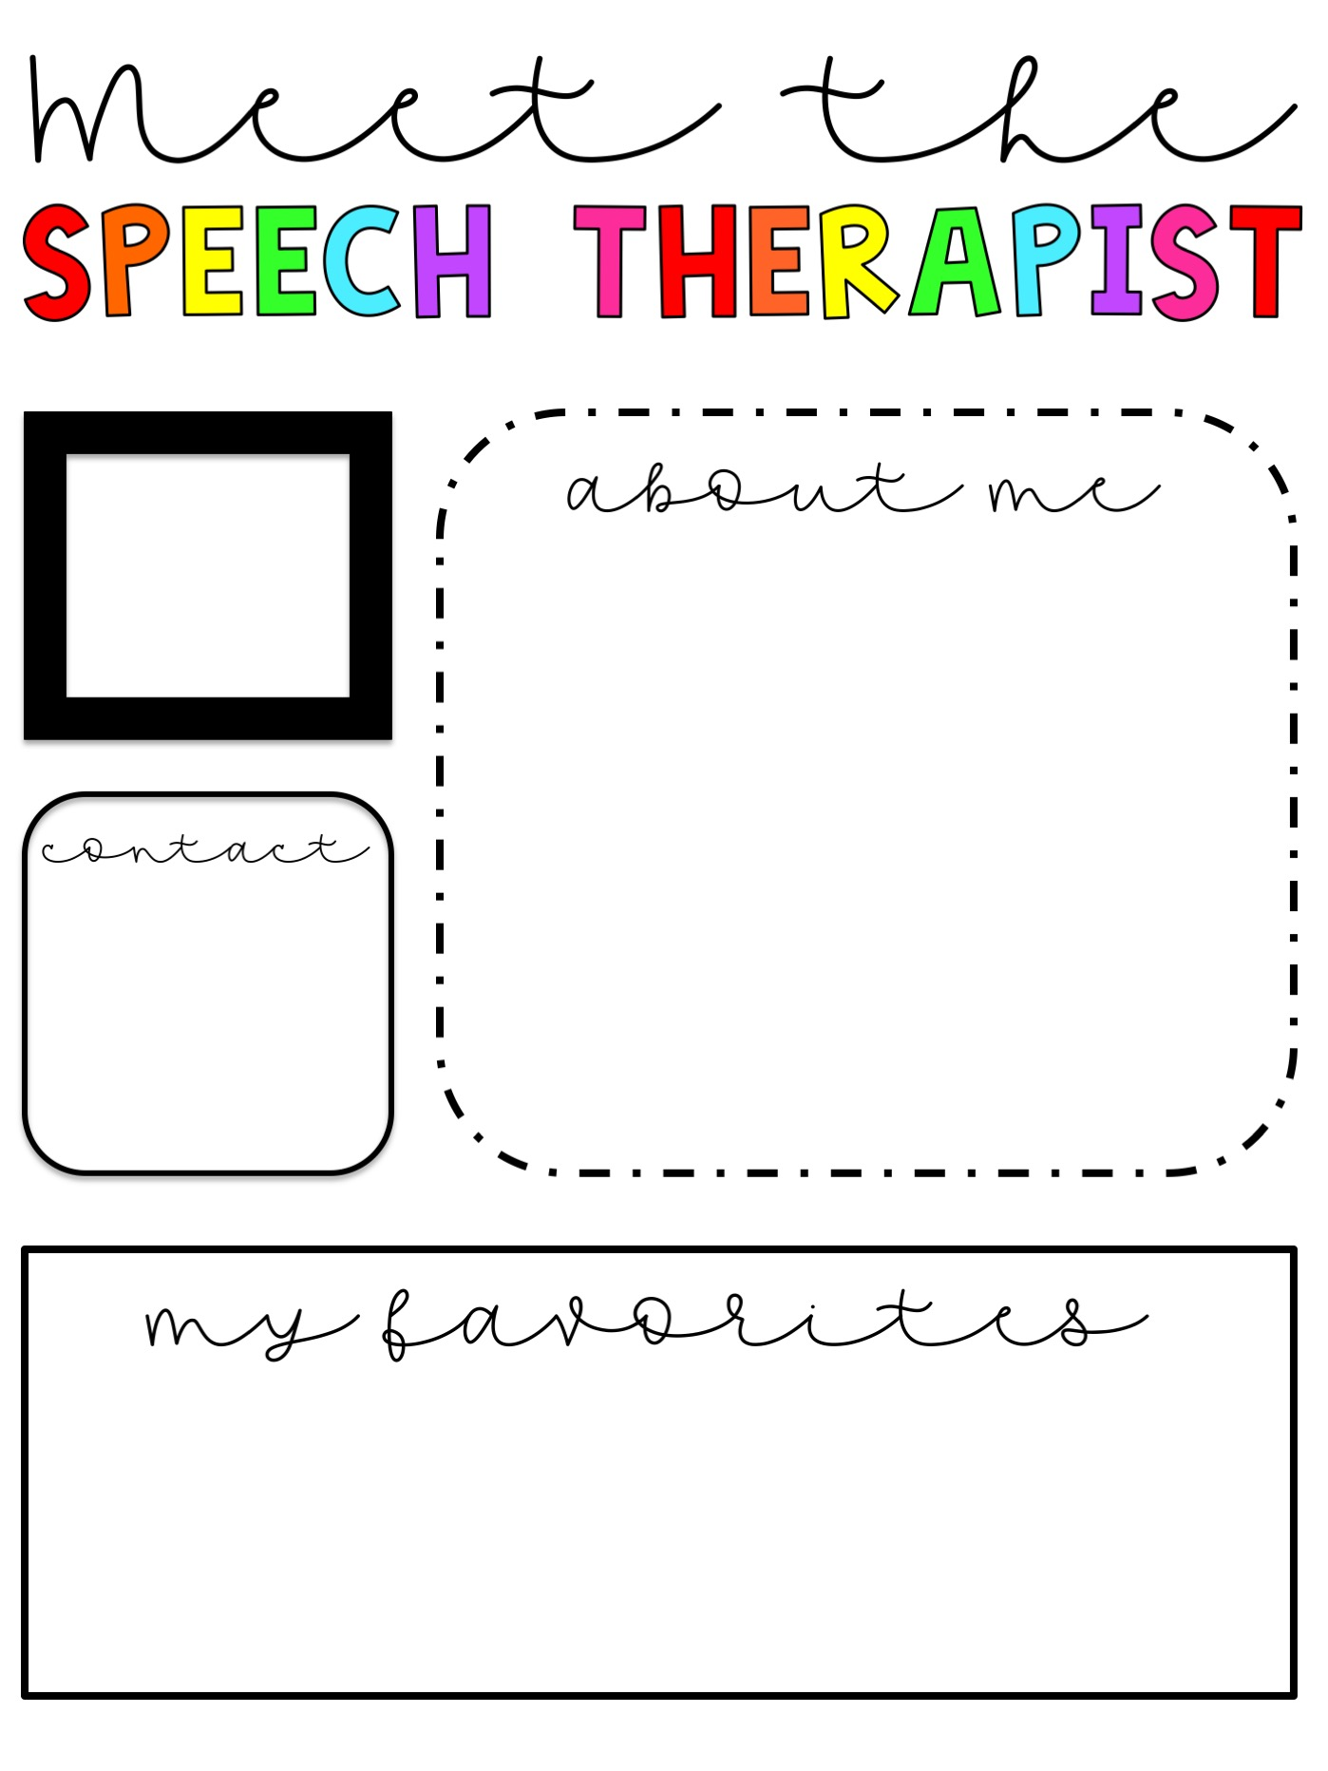
Insert picture here
Write your about me note here
Insert contact info here
Insert favorites here

Slide 12
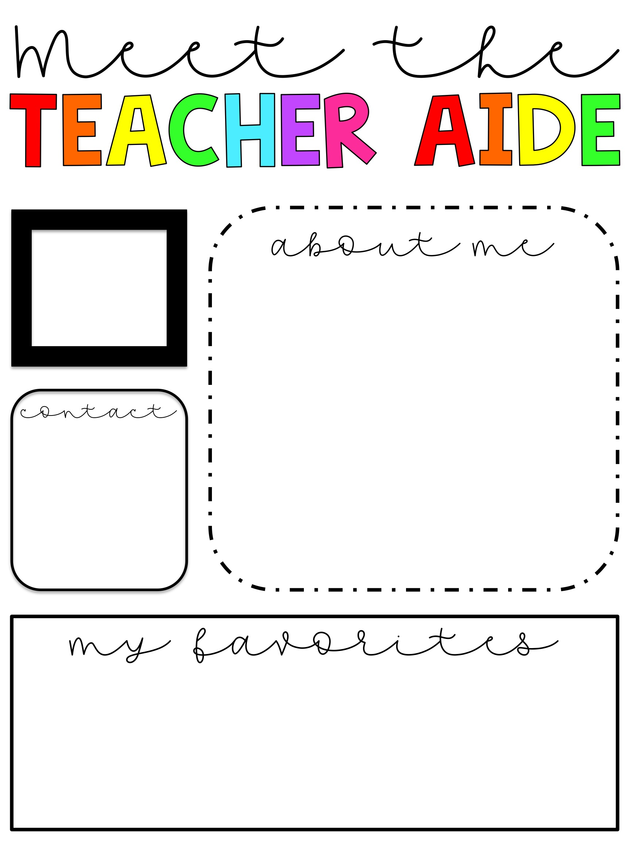
Insert picture here
Write your about me note here
Insert contact info here
Insert favorites here

Slide 13
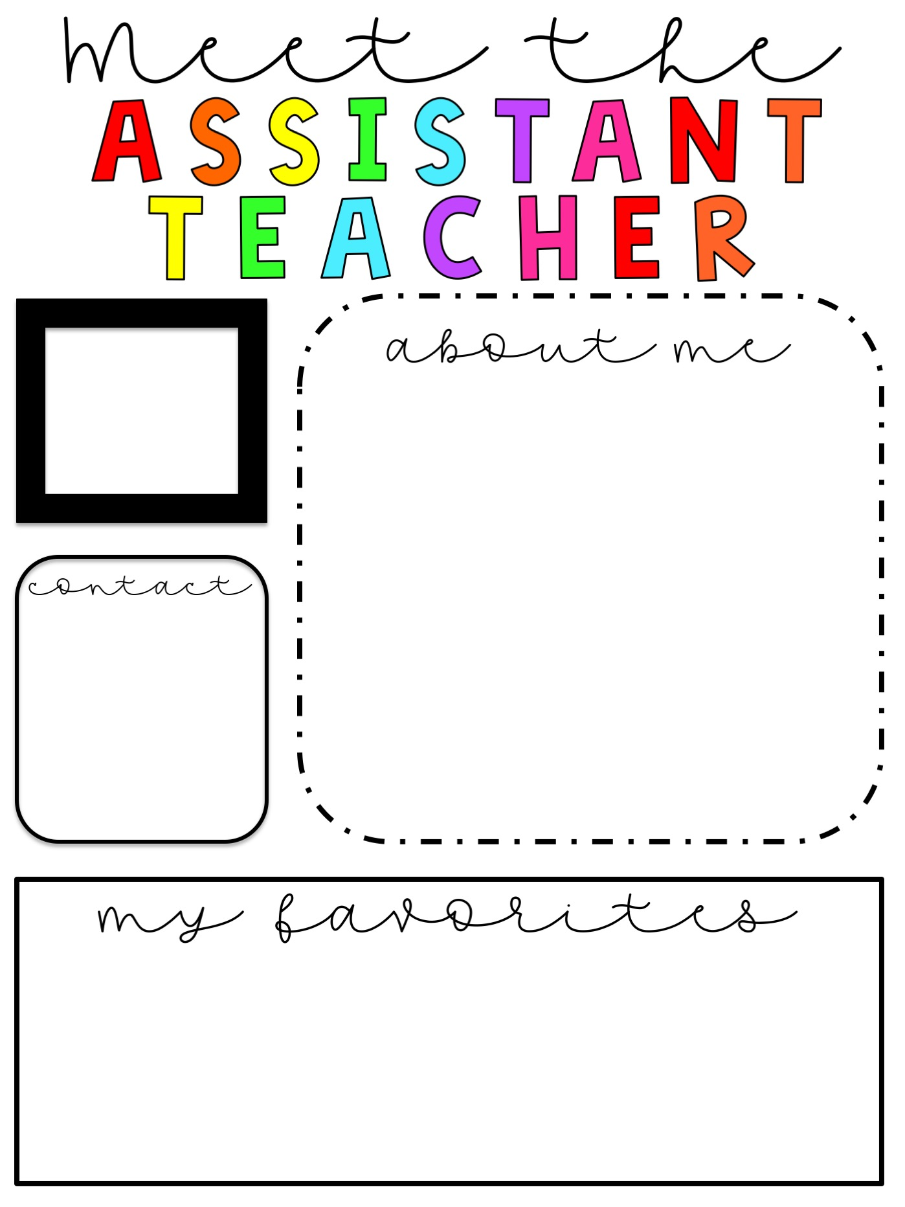
Insert picture here
Write your about me note here
Insert contact info here
Insert favorites here

Slide 14
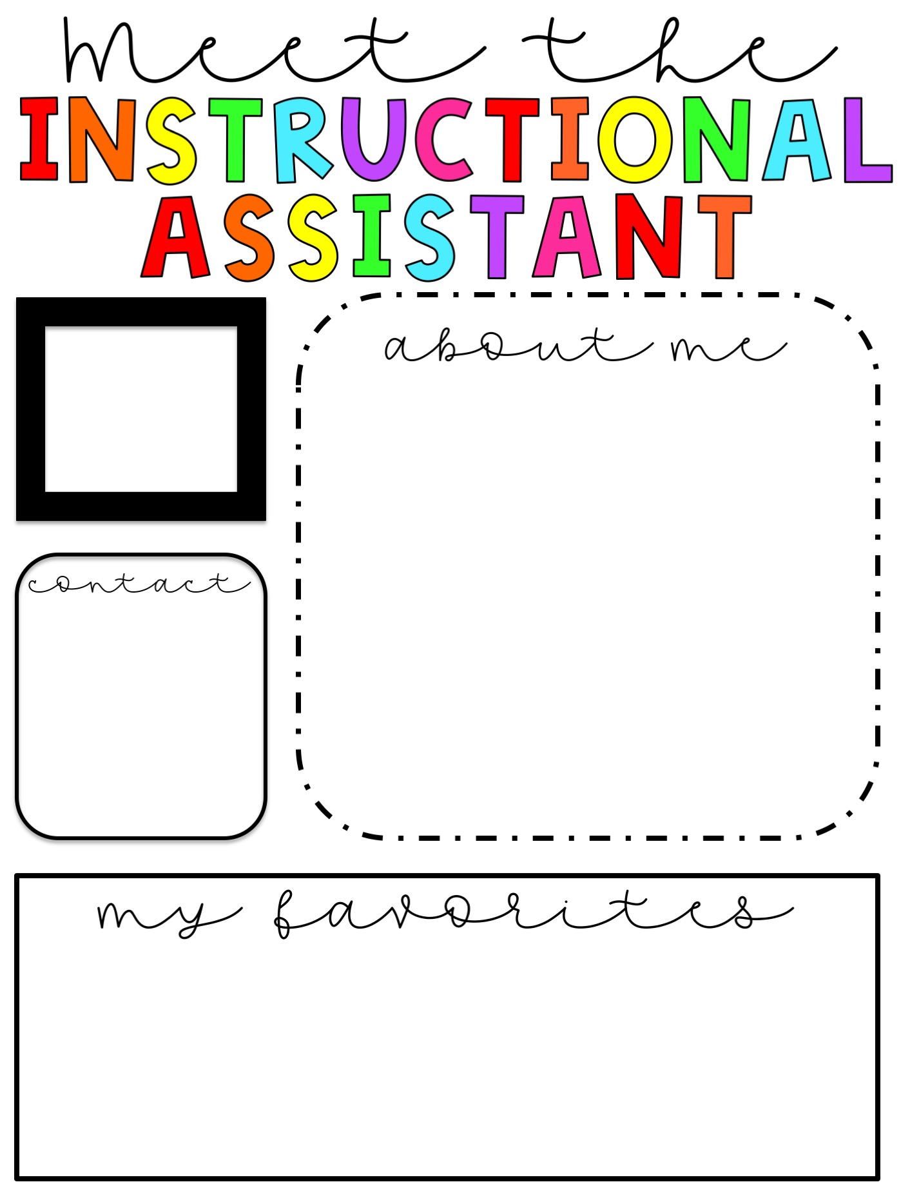
Insert picture here
Write your about me note here
Insert contact info here
Insert favorites here

Slide 15
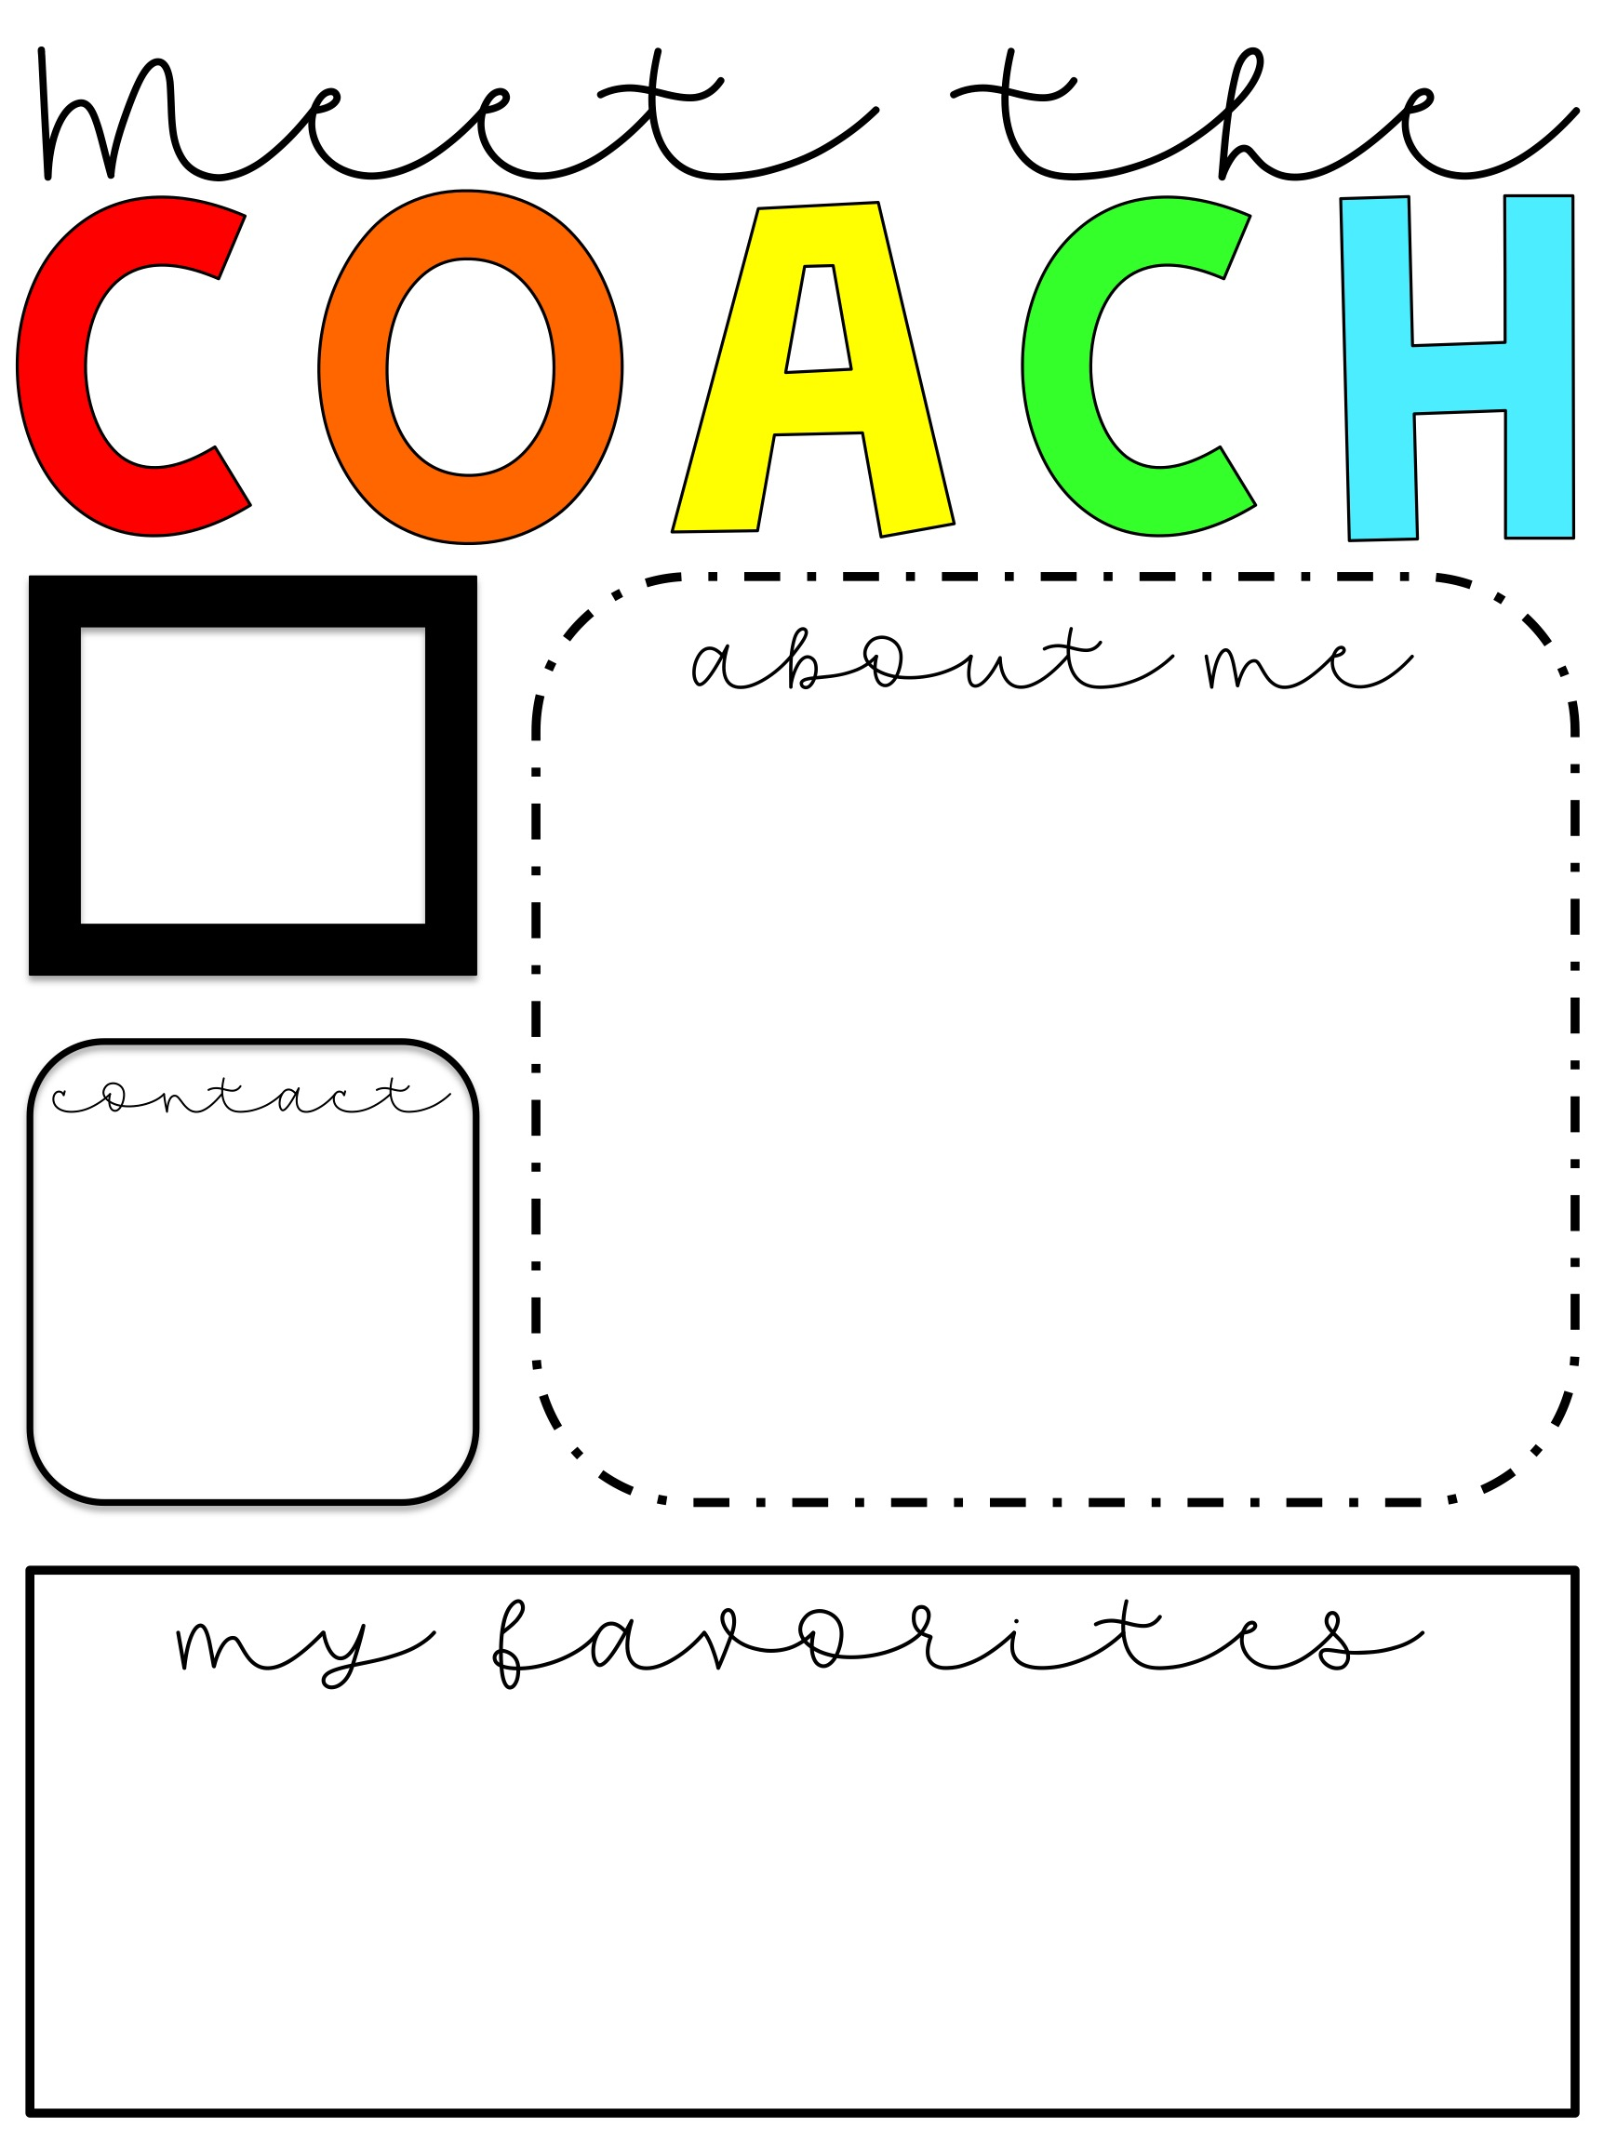
Insert picture here
Write your about me note here
Insert contact info here
Insert favorites here

Slide 16
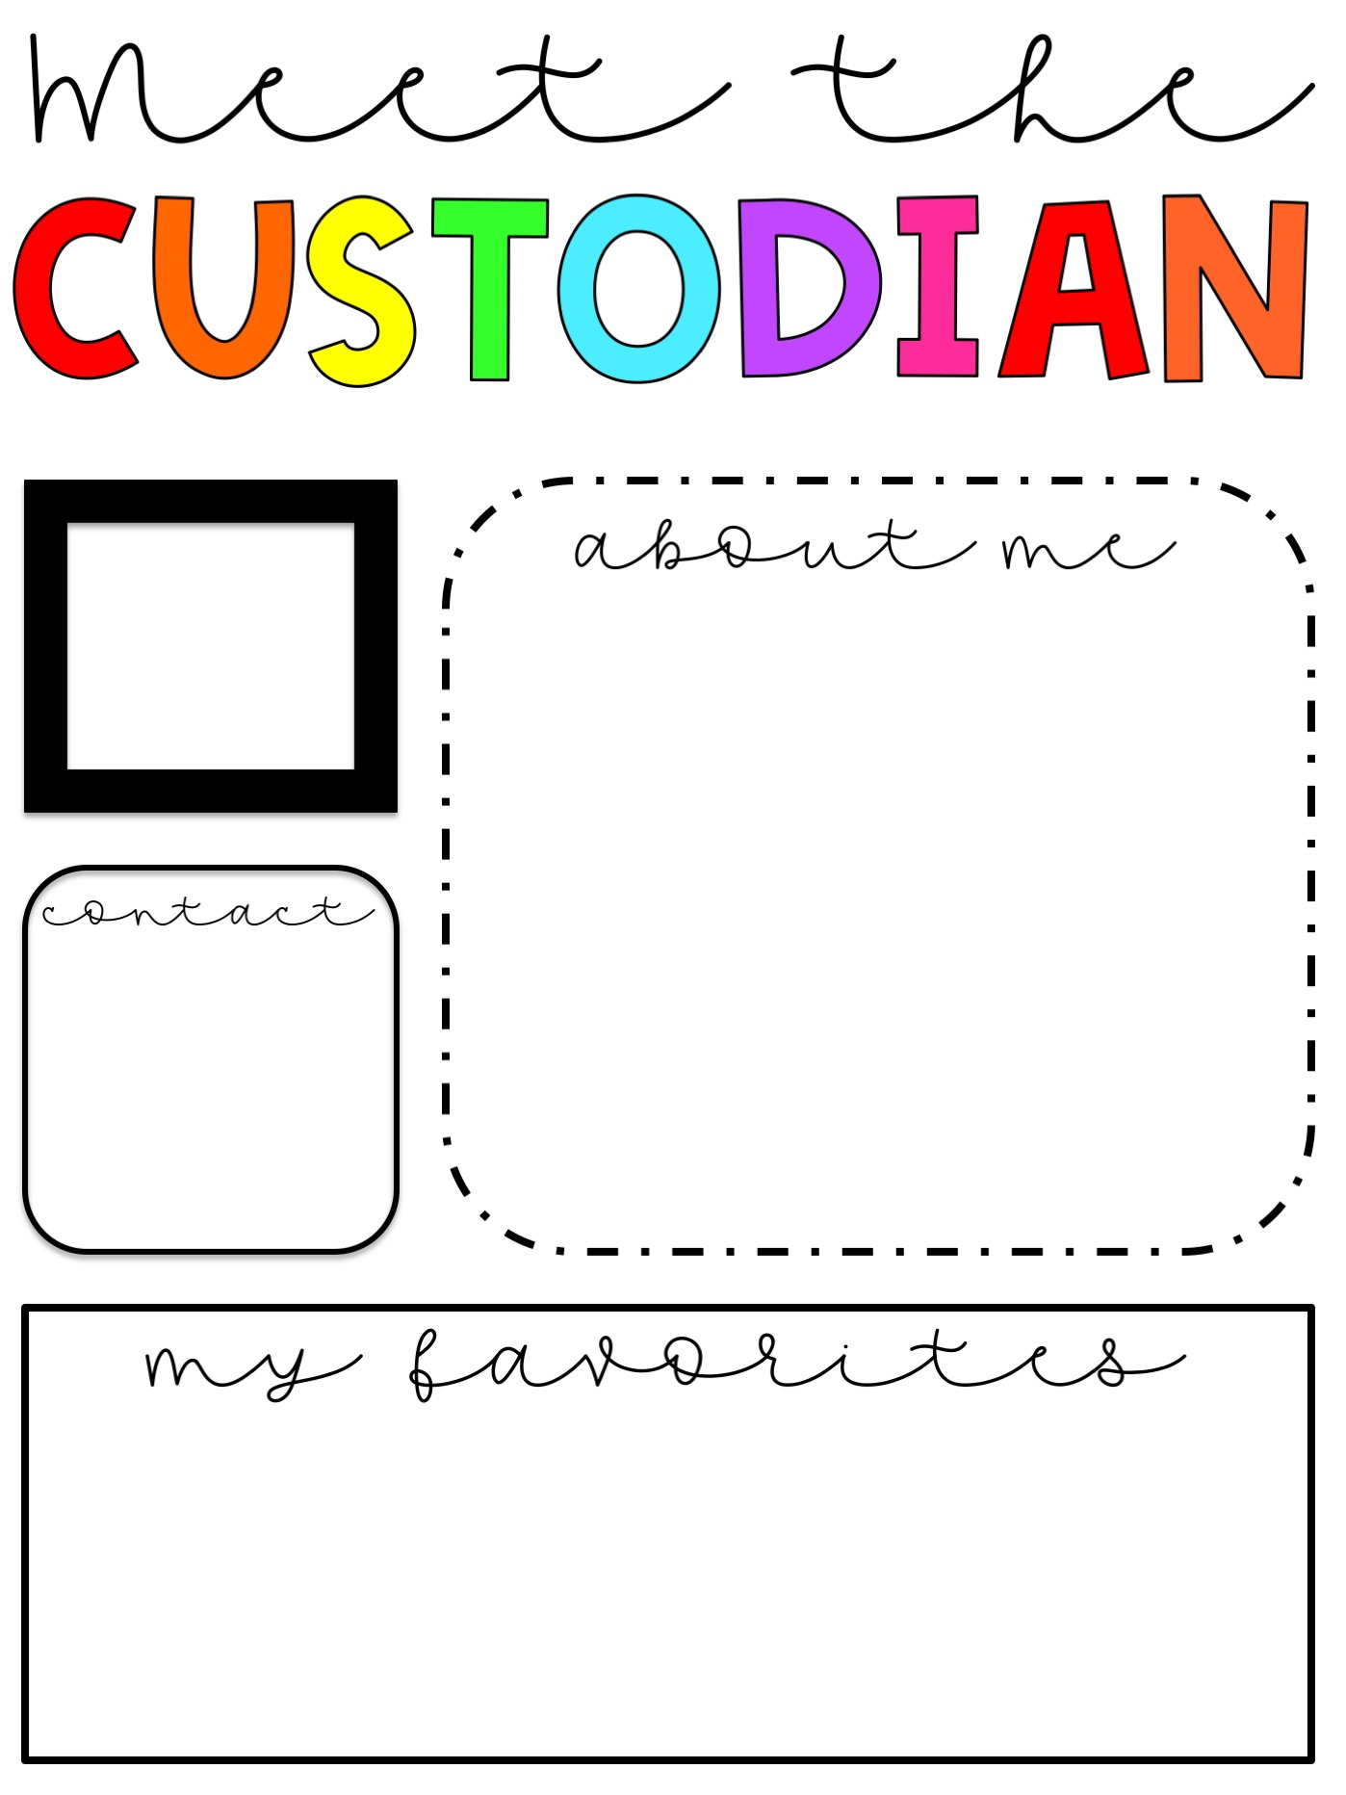
Insert picture here
Write your about me note here
Insert contact info here
Insert favorites here

Slide 17

Insert picture here
Write your about me note here
Insert contact info here
Insert favorites here

Slide 18
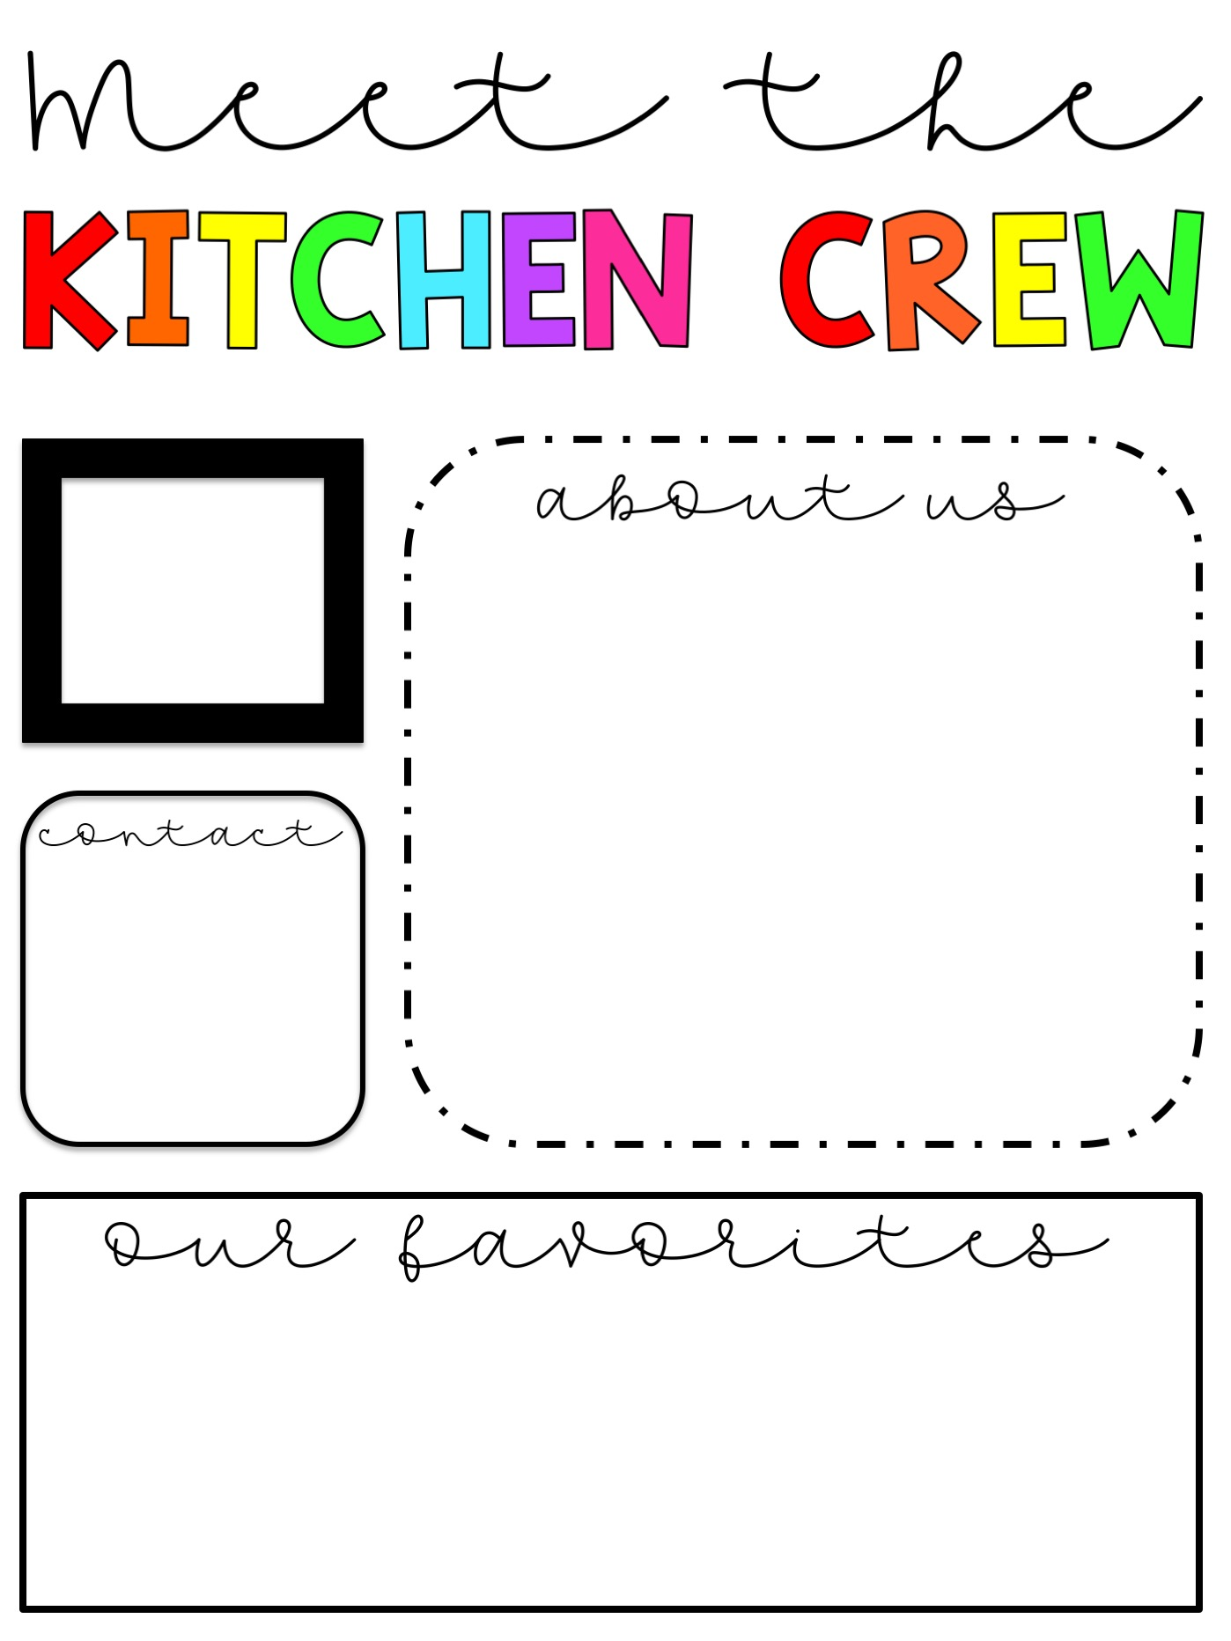
Insert picture here
Write your about me note here
Insert contact info here
Insert favorites here

Slide 19
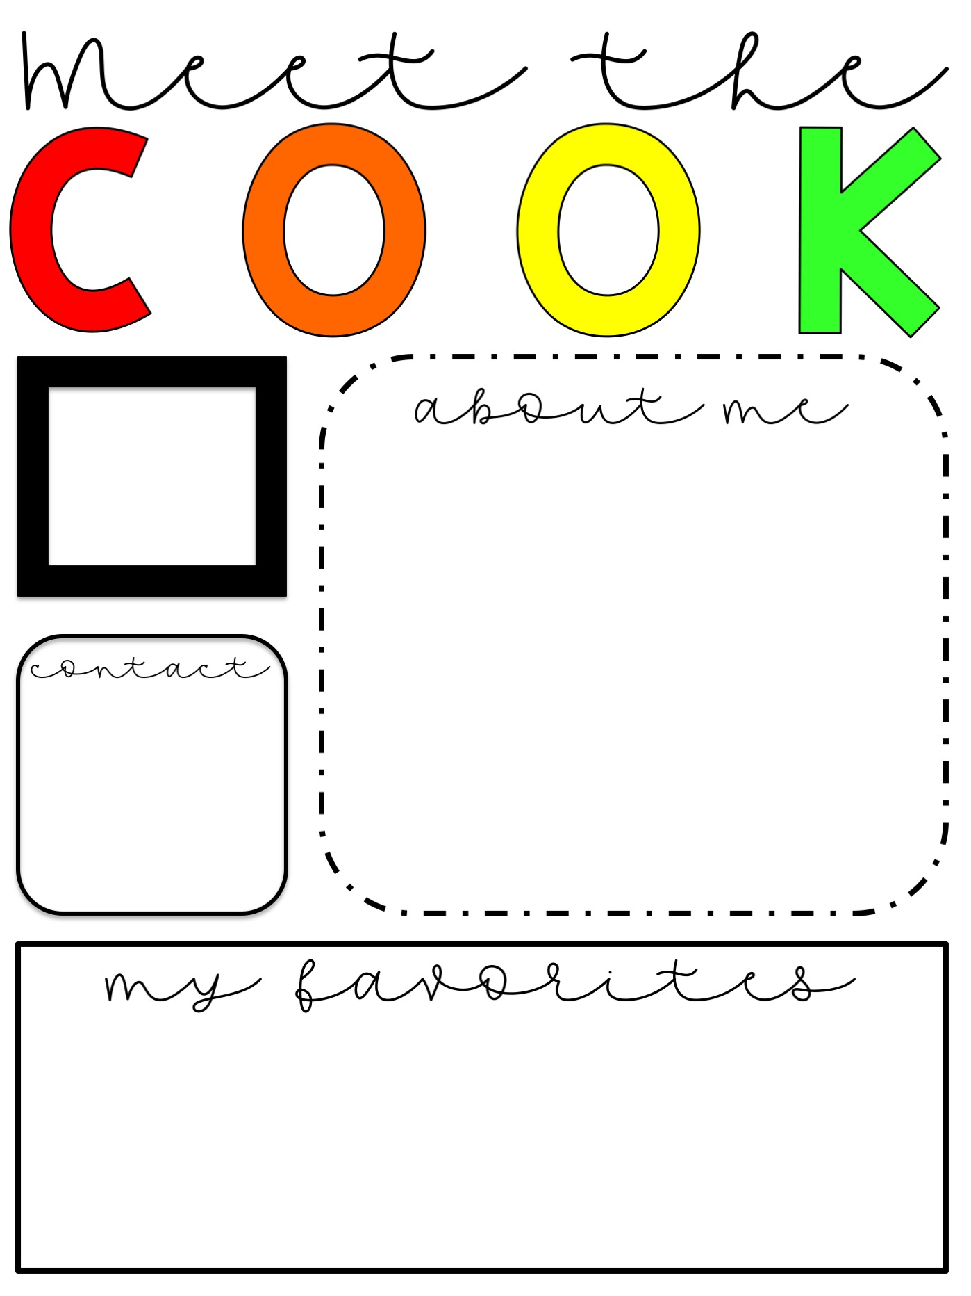
Insert picture here
Write your about me note here
Insert contact info here
Insert favorites here

Slide 20
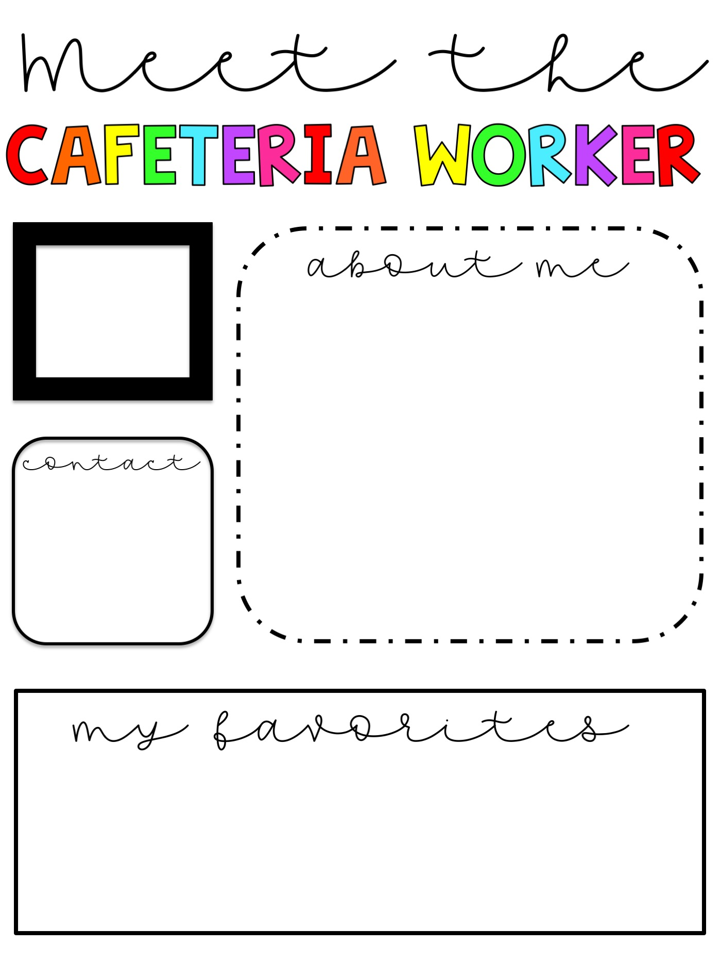
Insert picture here
Write your about me note here
Insert contact info here
Insert favorites here

Slide 21
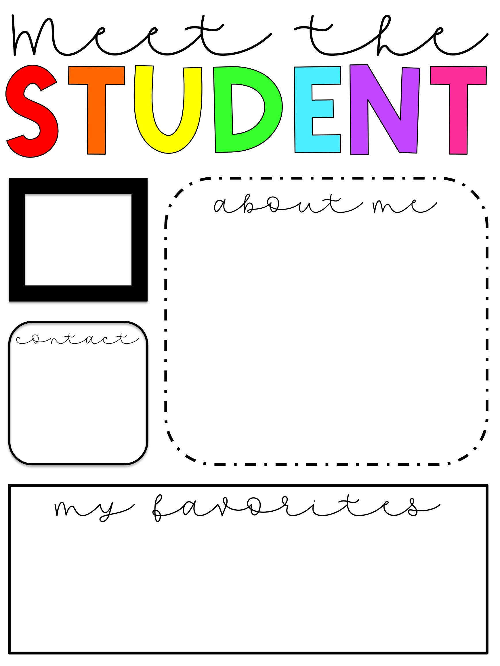

Slide 22





CREDITS & TERMS OF USE
•••••••••••••••••••••••••••••••
Thank you for your purchase!
I hope you love your new resources! If you have any questions or suggestions, please email me at theaverageteachertpt@gmail.com. Don’t forget that you can get credit for future purchases by leaving feedback on this resource! If you like this product, please follow my store so that you never miss a new product! Please review my terms of use below before using. I hope your students enjoy this resource!
- Kayla Bernardez
Terms of Use
YOU MAY | YOU MAY NOT
Use this resource for PERSONAL use only | SELL this resource or use it for monetary gain
PRINT, COPY, and, DISTRIBUTE this resource to students you teach | SHARE this resource with other teachers or distribute to students whom you do not teach ** Additional licenses can be purchased for this purpose
SAVE this resource on your personal and/or work computer | CLAIM this resource as your own
Credits:

